Slide 1
GraphQL Specifications

Slide 2
Introduction GraphQL Specifications
The GraphQL specification is divided into two main sections:
The Language
The Type System
It is our attack surface which is the sum of all possible attack vectors an adversary can use.

Slide 3
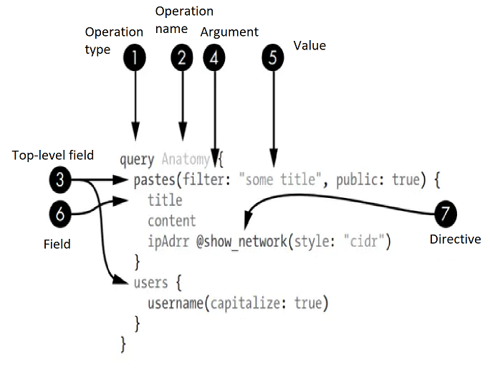
The Language: Query Anatomy

Slide 4
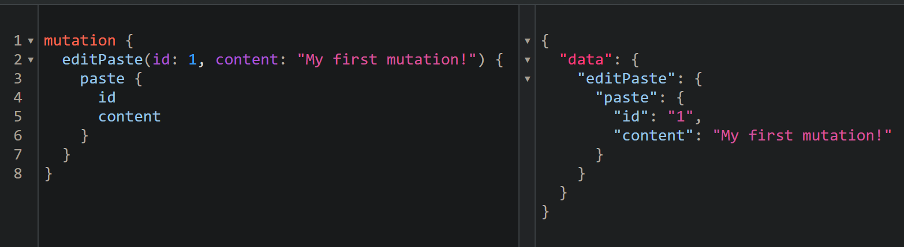
Operation Types: Mutations
Function: Allows changing and reading data simultaneously.
Notes:
UPDATE pastes SET content = 'My first mutation!’ WHERE id = 1;
SELECT id, title, content FROM pastes WHERE id = 1;
For MySQL 8.0.21+,
UPDATE pastes SET content = 'My first mutation!’ WHERE id = 1 RETURNING id, title, content;

Slide 5
Operation Types: Subscriptions
Function: Bidirectional retrieval of real-time data via WebSocket.
Process: Starts with a handshake upgrading HTTP to WebSocket.
Security Risks:
CSWSH (Cross-Site WebSocket Hijacking): If origin is unchecked.
MITM (Man-In-The-Middle): If connection is unencrypted.

Slide 6
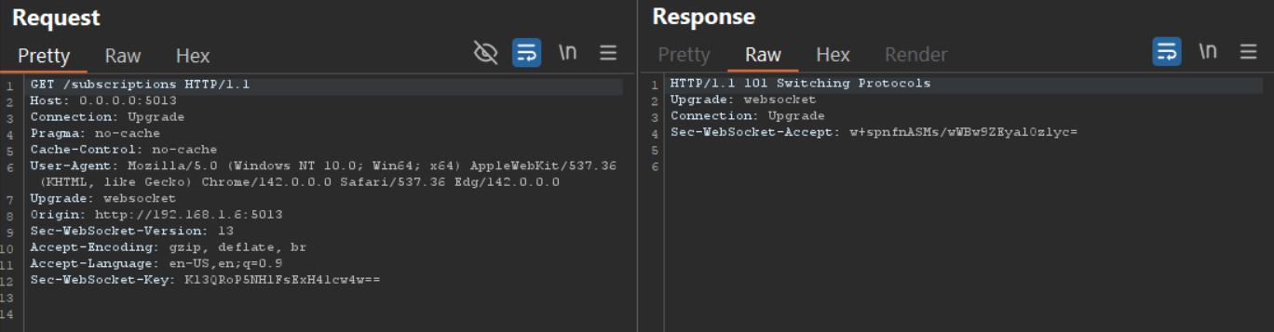
Operation Types: Subscriptions
Start HTTP connection.
Ask to switch.
Upgrade to WebSocket.

Slide 7
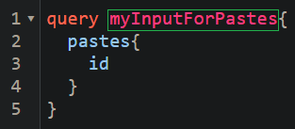
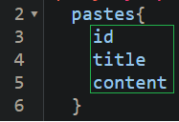
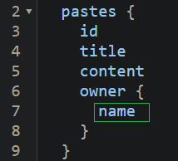
Operation Names & Fields
GraphQL operation names are labels used to uniquely identify an operation in certain contexts.
A field is a single piece of information available within an operation’s selection set ({}).
It may contain their own selection set.
Notes:
SELECT u.id, u.title, u.content, o.name AS owner_name
FROM users u
LEFT JOIN owner o ON u.owner_id = o.id;

Slide 8
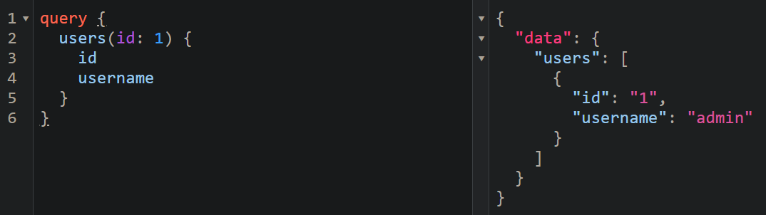
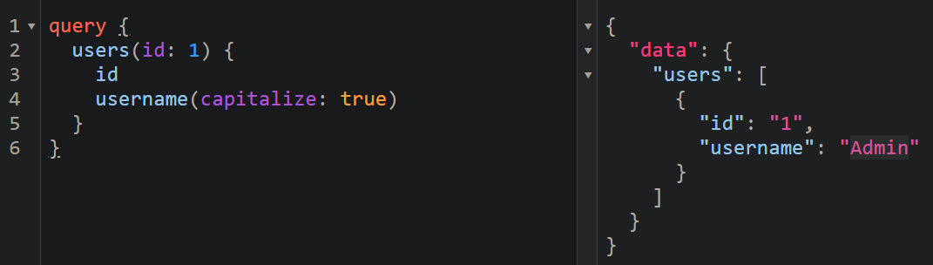
Arguments
GraphQL allows clients to send arguments for various fields in their queries to specify the results.
Notes:
SELECT CONCAT(UCASE(LEFT(username, 1)), SUBSTRING(username, 2)) AS username FROM users WHERE id = 1;

Slide 9
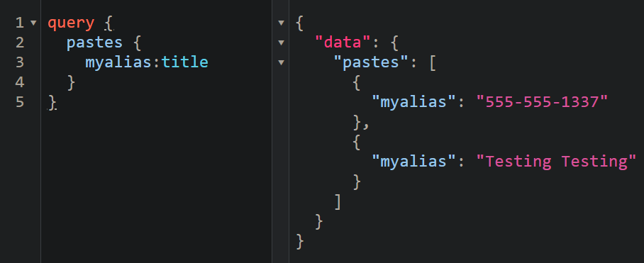
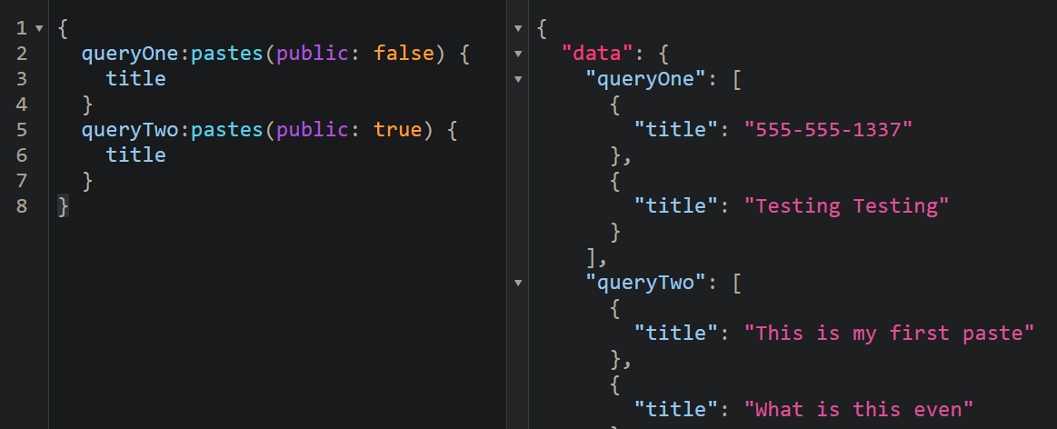
Aliases
Aliases allow clients to change a field’s response key to something other than the original field’s.
Notes:
SELECT title AS myalias FROM pastes;

Slide 10
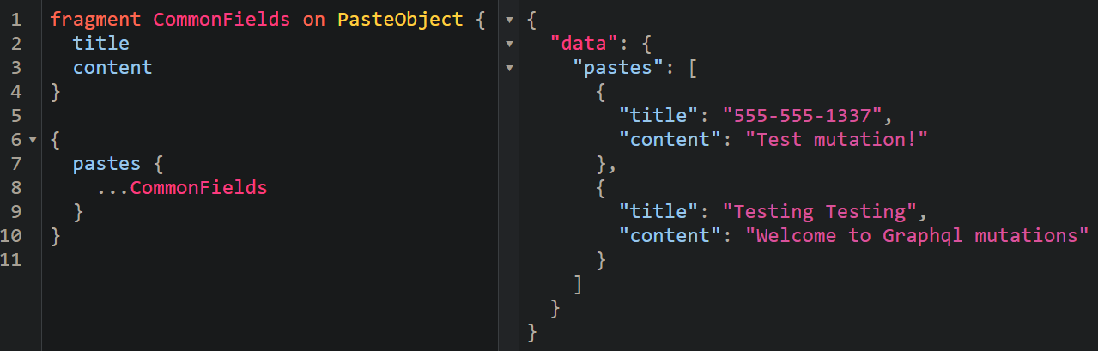
Fragments
They are a way to reuse fields in your GraphQL queries for avoiding repetition and improving readability.

Slide 11
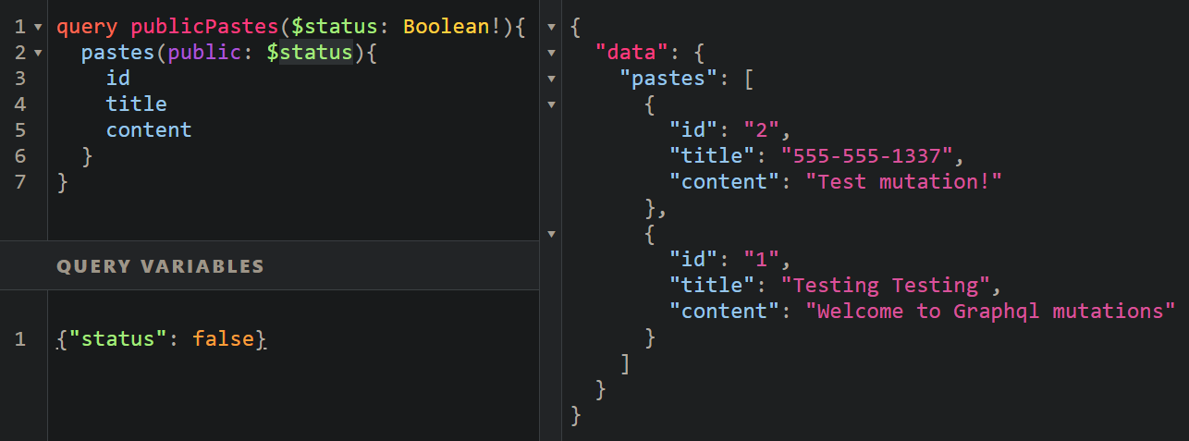
Variables
Variables let you make your queries more dynamic, without rewriting the entire query every time.
$ ⇒ To provide variable name.
! ⇒ Means variable is required.
Notes:
SELECT id, title, content FROM pastes WHERE public = ?;

Slide 12
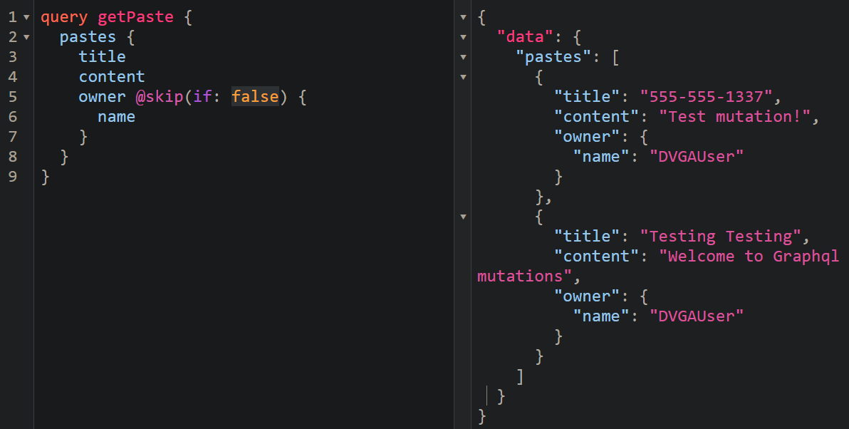
Directives
Directives are special annotations used to change the behavior of a field, fragment, or type dynamically without changing the query structure.
There are two main types of directives:
Query-level ⇒ In the actual query (used by clients) like: @skip, @include, @defer

Slide 13

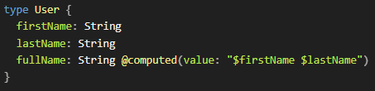
Directives
Schema-level ⇒ In the schema definition (used by developers) like: @deprecated, @computed, @specifiedBy
Custom Directives ⇒ Developers created to enhance behavior like : @computed

Slide 14
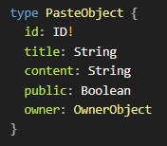
The Type System: Scalars & Objects
GraphQL’s types define the custom objects and data structures that make up a GraphQL schema.
Scalars are primitive values with no nested fields or objects like: ID, String, Int, Float, Boolean.
Object types define custom data structures with multiple fields.
! ⇒ Means id is required in each object.
owner ⇒ Another object

Slide 15
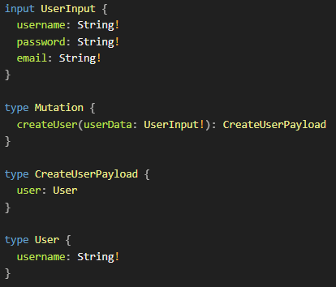
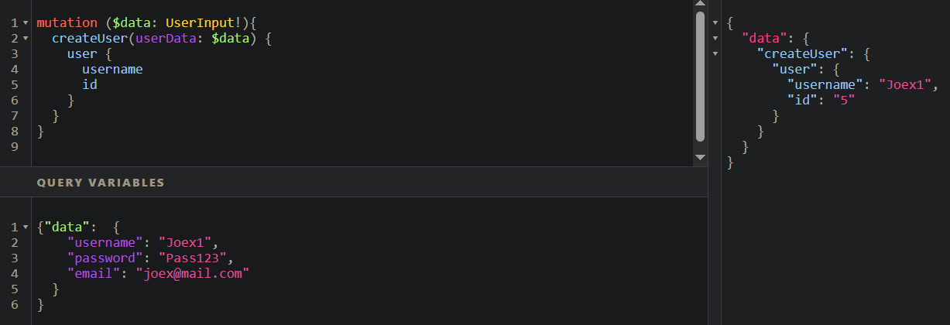
Inputs
They are used when you need to pass structured, complex data (like objects) as arguments to a query or mutation.

Slide 16
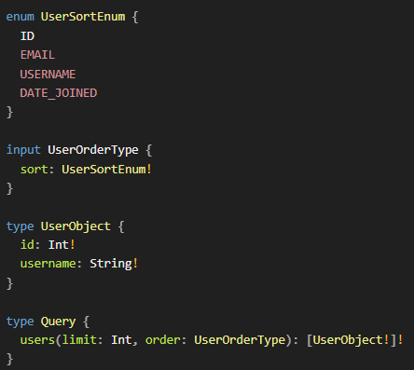
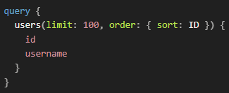
Enums
They are predefined list of string values used to restricts client input (validates arguments like sorting).
Notes:
SELECT id, username FROM users ORDER BY id ASC LIMIT 100;

Slide 17
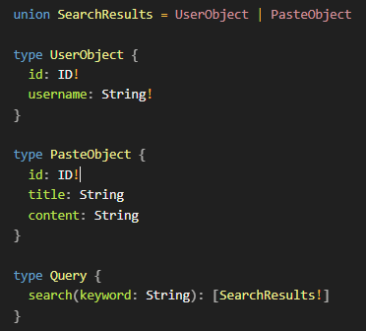
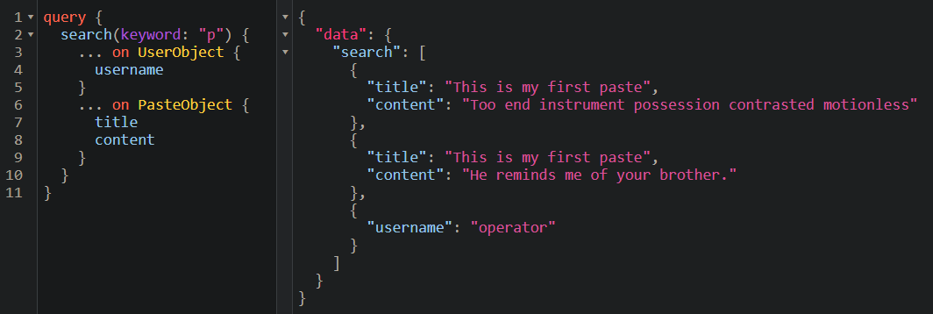
Unions
Unions allow a field to return one of multiple object types.

Slide 18
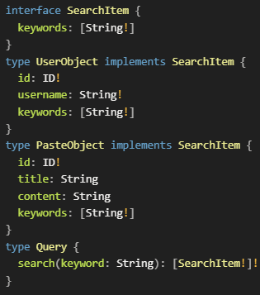
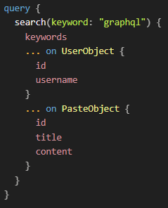
Interfaces
Another way to return multiple types within the same field is through interfaces.
Interfaces require all implementing types to have the same fields (at least the ones defined in the interface).

Slide 19
Introspection
It is a built-in tool that empowers clients to discover actions they can take using a GraphQL API.
It lets clients query a GraphQL server for information about its underlying schema, which includes data like queries, mutations, subscriptions, directives, types, fields, and more.

Slide 20
Introspection
The Introspection System Types :
Introspection type | Usage
__Schema | Provides all information about the schema of a GraphQL service
__Type | Provides all information about a type
__TypeKind | Provides the different kinds of types (scalars, objects, interface, union, enum, and so on)
__Field | Provides all information for each field of an object or interface type
__InputValue | Provides field and directive argument information
__EnumValue | Provides one of the possible values of an enum.
__Directive | Provides all information on both custom and built-in directives

Slide 21
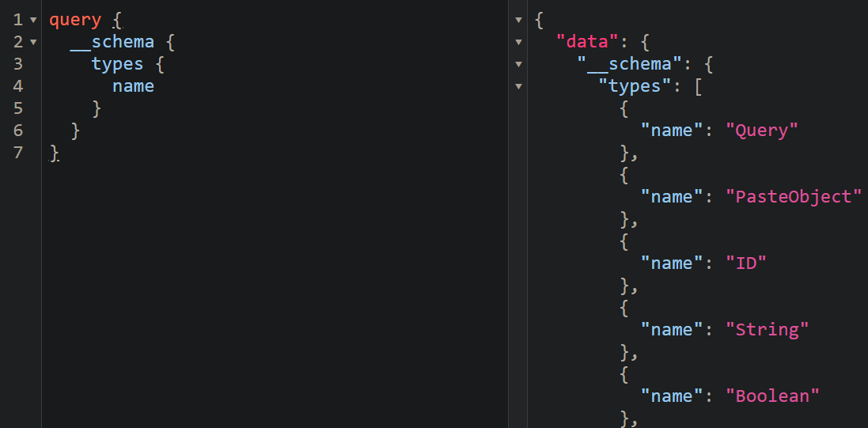
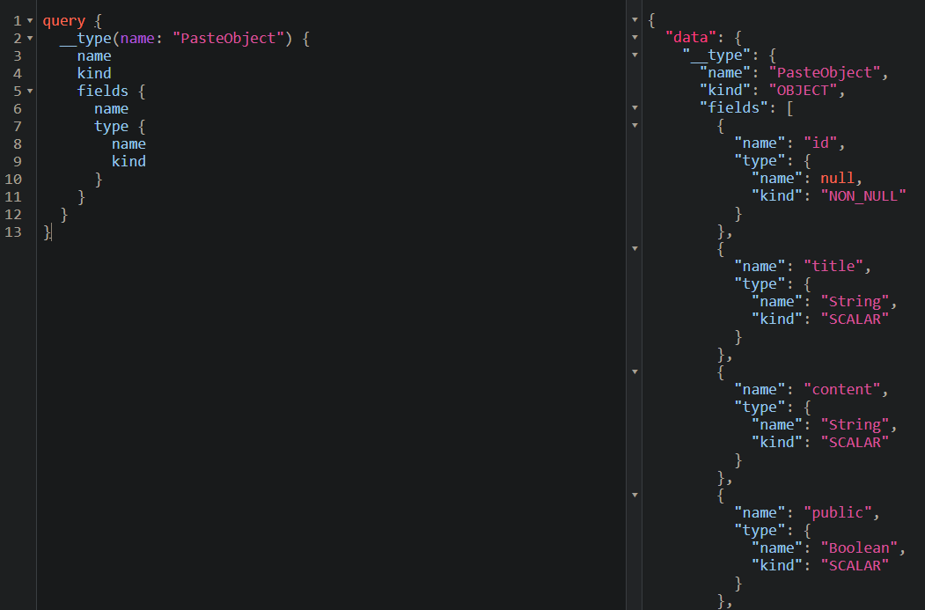
Introspection

Slide 22
Thanks for watching!

